Slide 1
gdsfactory
https://github.com/gdsfactory/gdsfactory
Keyla Domingos Lopes

Slide 2
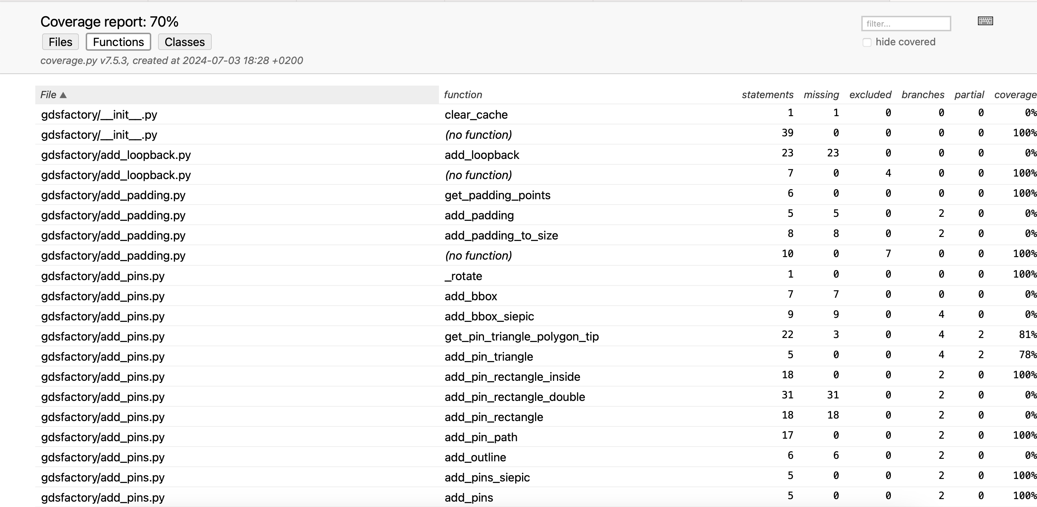
Original coverage results

Slide 3
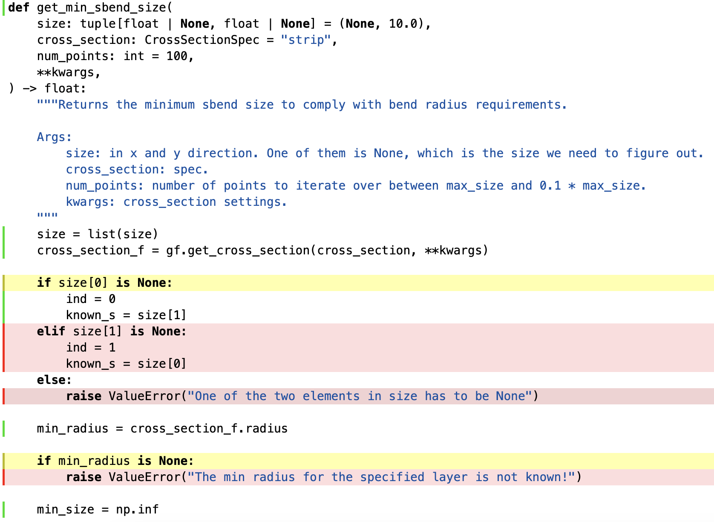
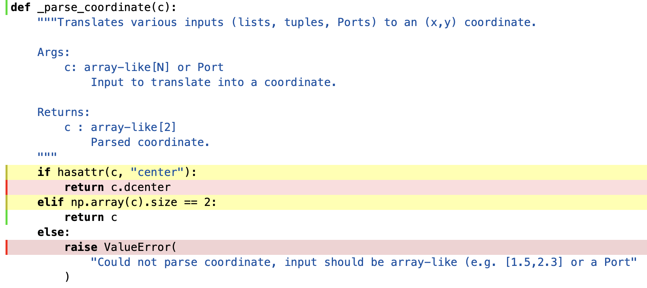
Analysis of uncovered parts

Slide 4
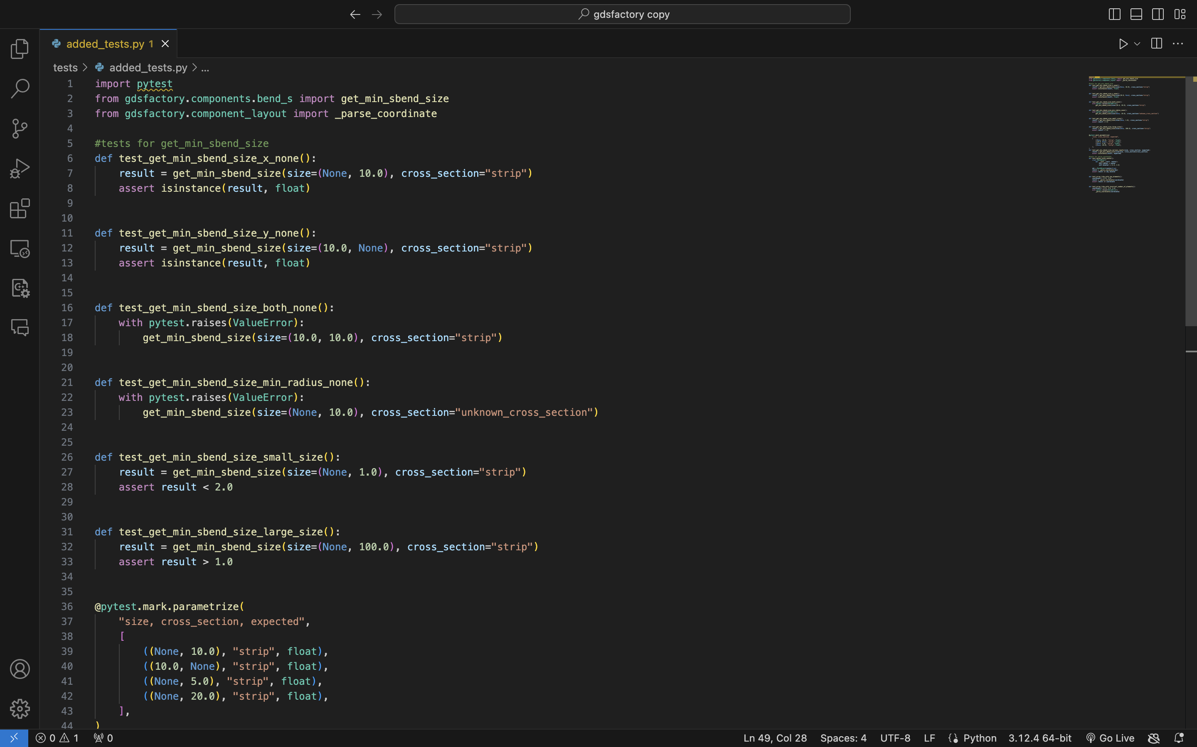
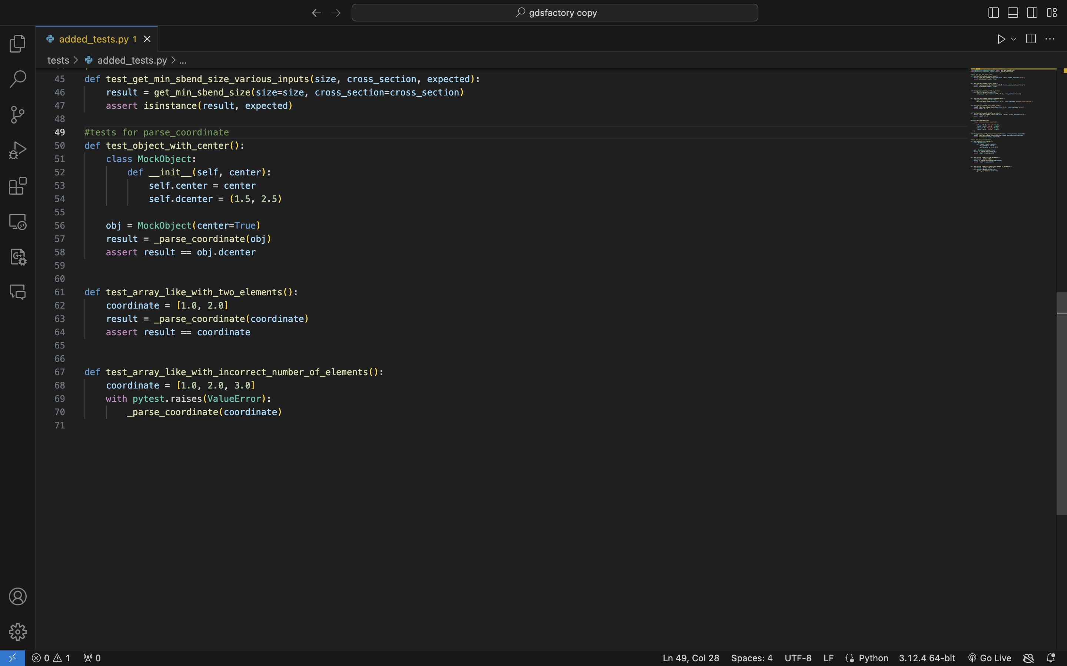
Coverage improvement

Slide 5
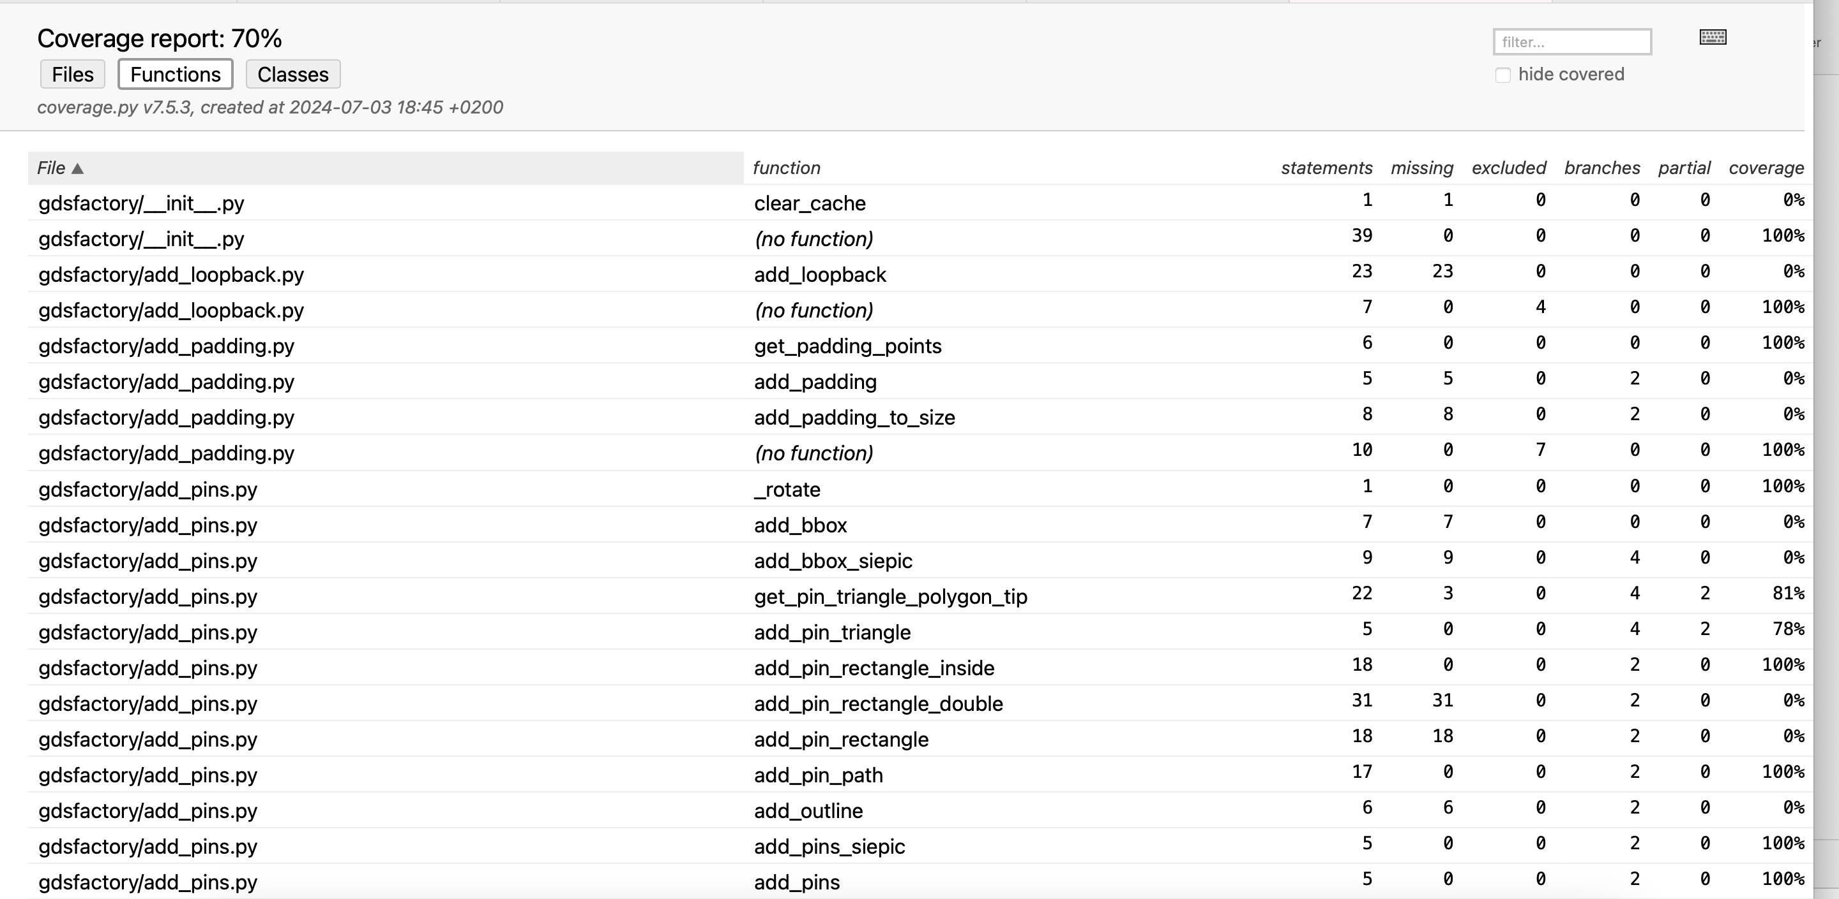
New coverage results

